Slide 1

Instagram Fashion Trend analysis

Slide 2
Agenda
Introduction
CV Model
Proposed Methodology
Integration and Final Model
Data Collection
Data Cleaning
User Interface
Sentiment Analysis
Future Work
EDA

Slide 3

Introduction

Slide 4

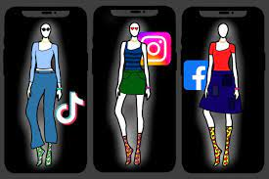

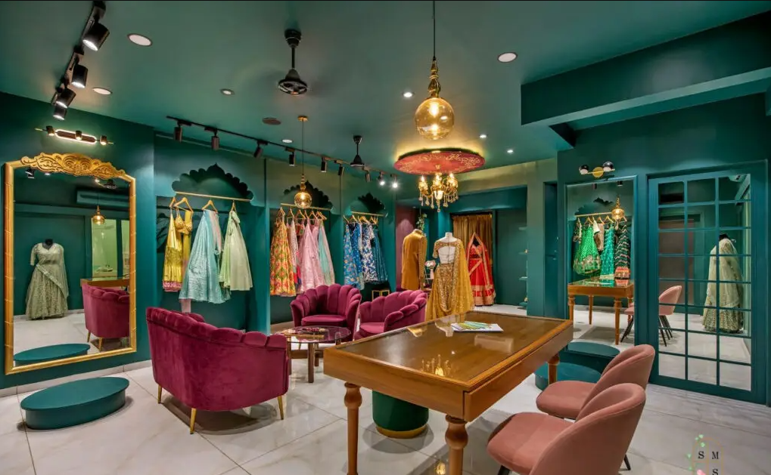
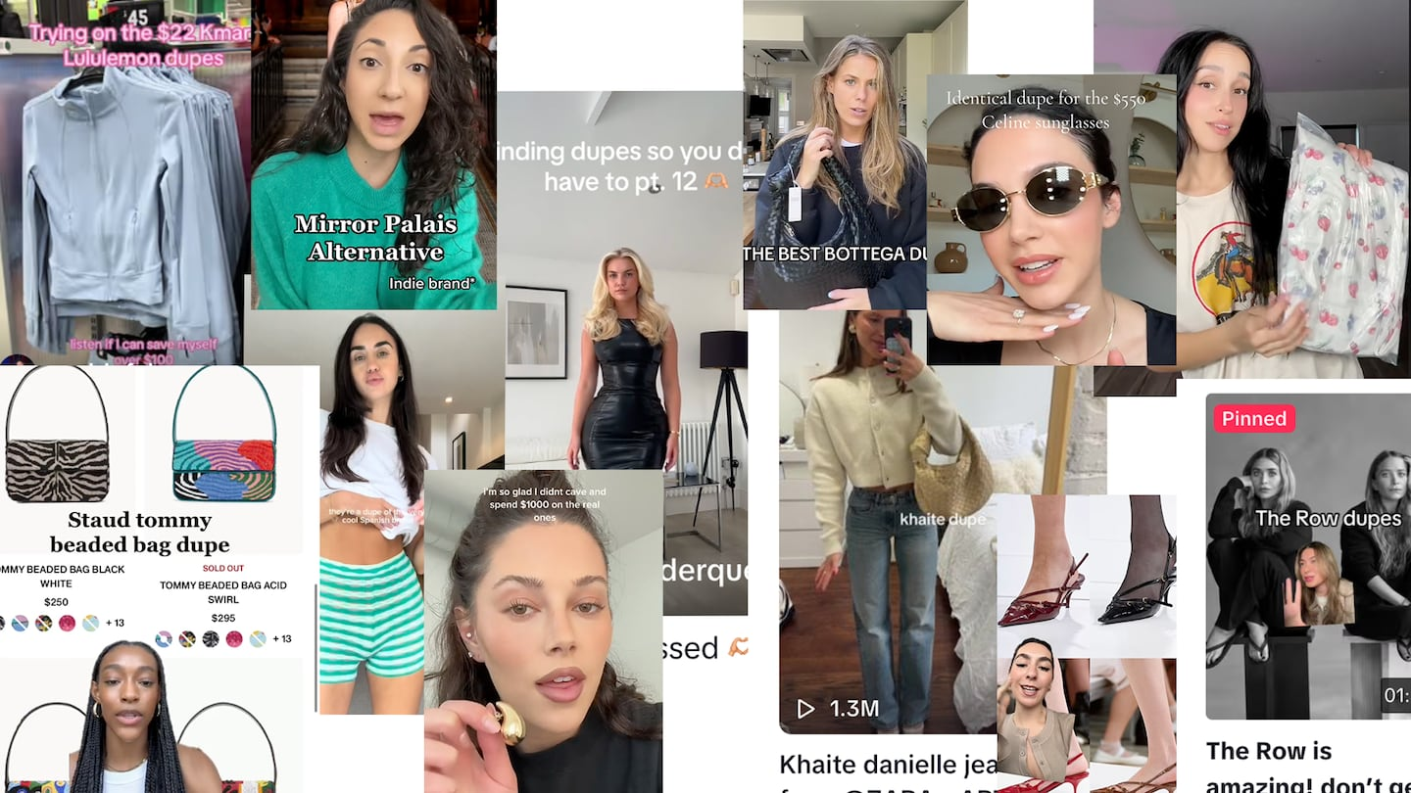
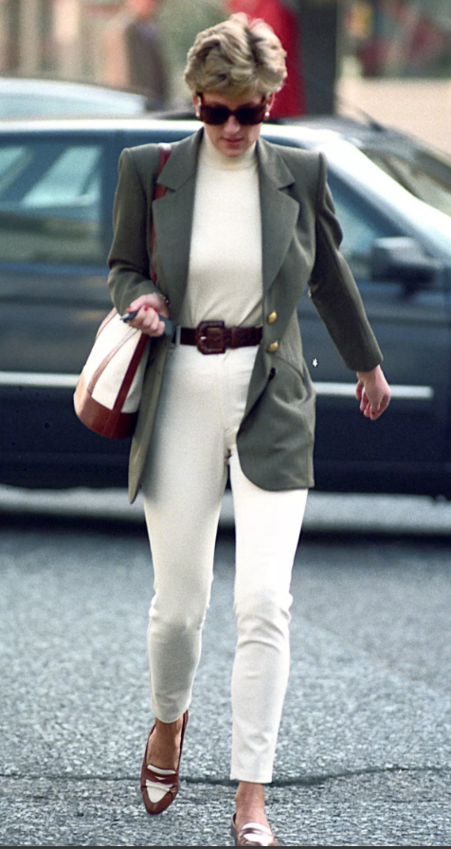
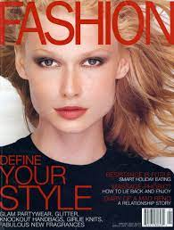
Fashion Trend Influence
Fashion Houses and Designers
Fashion Magazines
Celebrities
Social Media Platforms
Influencers
User-Generated content
THEN
NOW

Slide 5
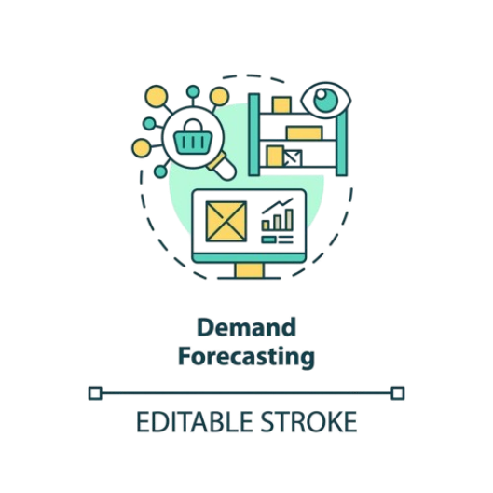
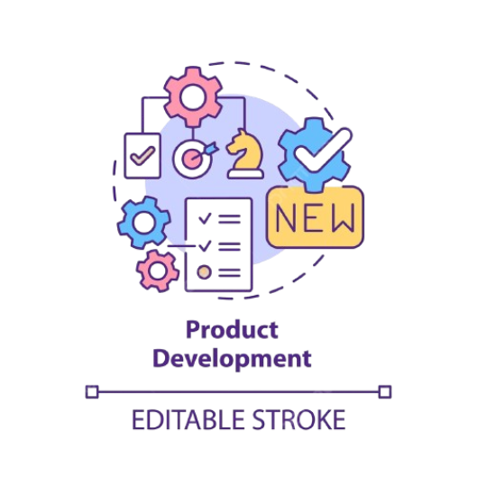
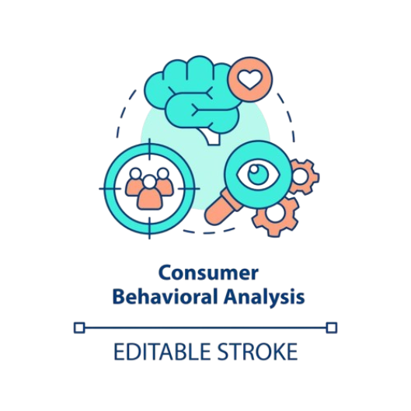

Fashion Trend Analysis – Business Usage

Slide 6




Fashion Trend Analysis – Users
Fashion Brands
Marketing Agencies
Influencers
Investors

Slide 7

Proposed Methodology

Slide 8
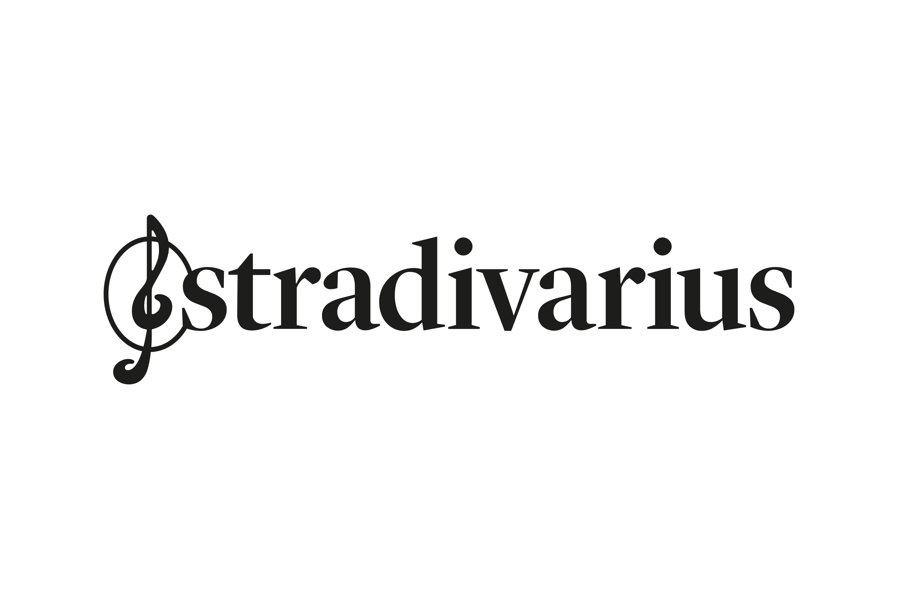


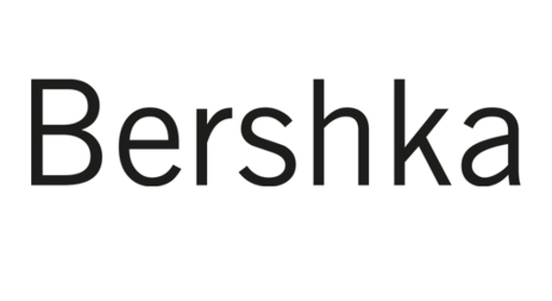

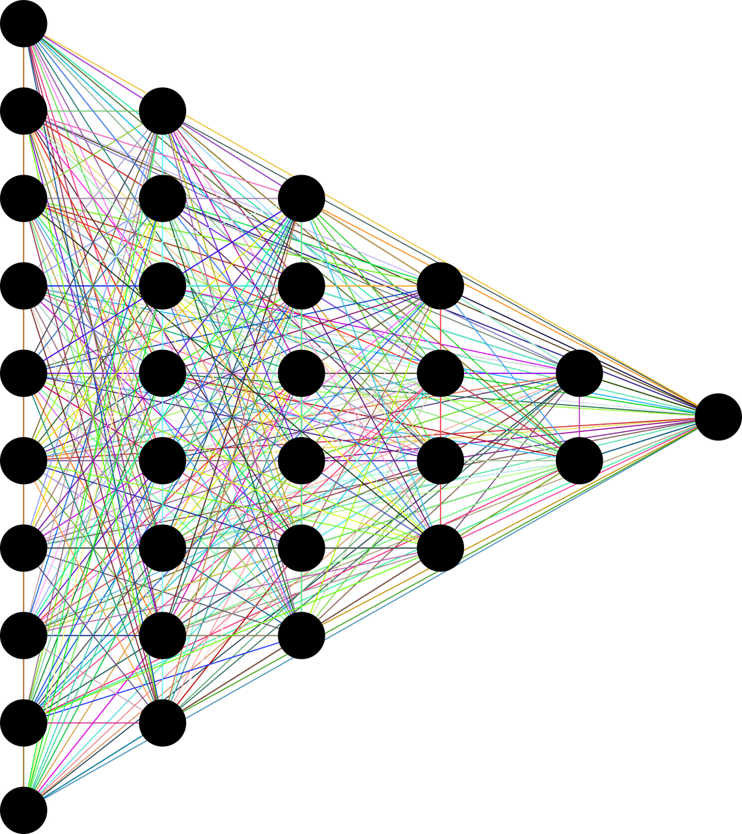




Proposed Methodology
3
Sentiment Analysis Model
5
Sentiment Score
Trendy?
Likes_count
Normalized_Count
Normalized Likes
Comments
1
Instagram Link
2
Brand
Brand
post_id
Image_link
Relevant Item
Post caption
4
CV Model
(Relevant Items)
Caption Embeddings

Slide 9

Data Collection

Slide 10
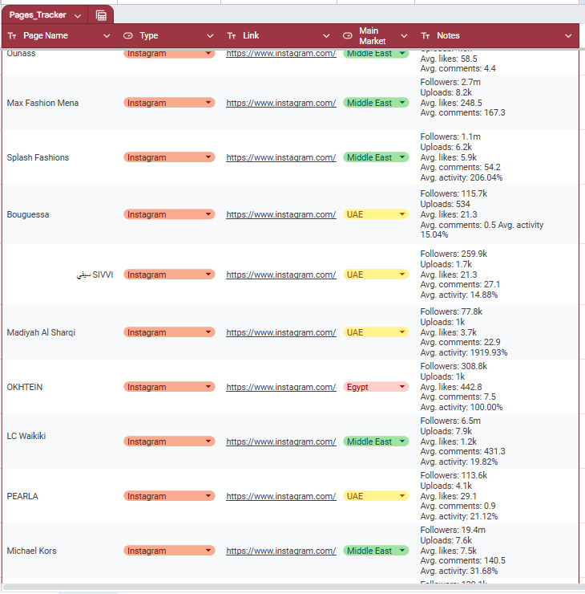
Data Collection

Slide 11
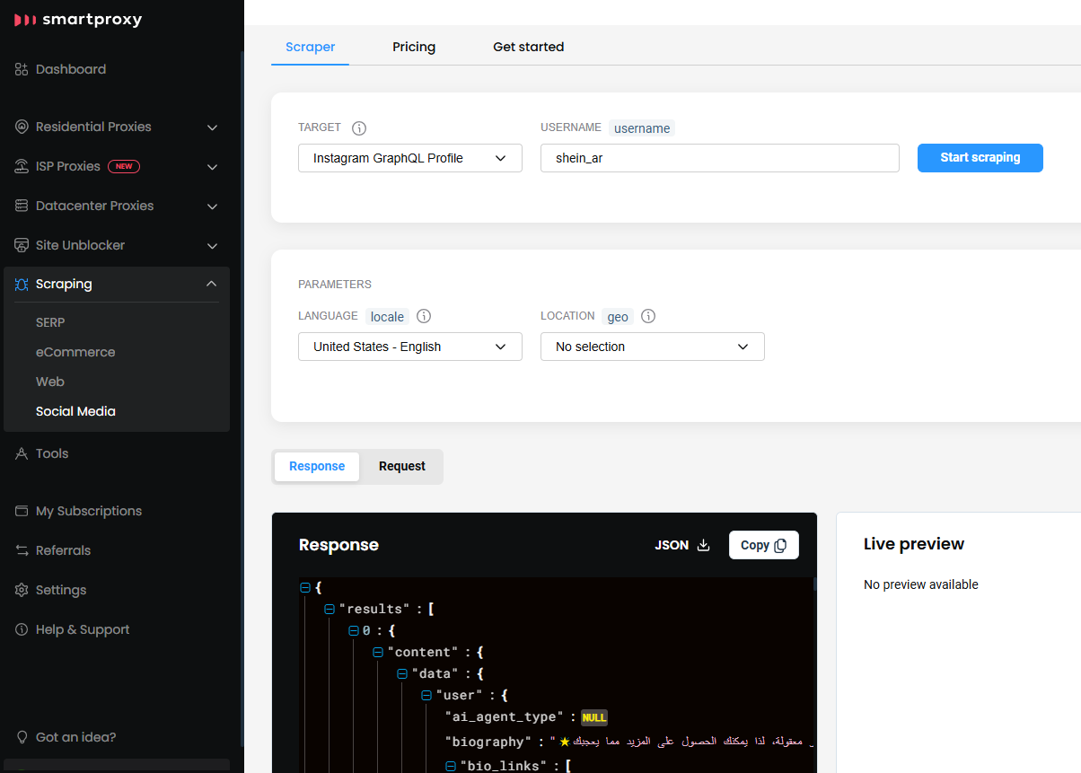
Scraping

Slide 12
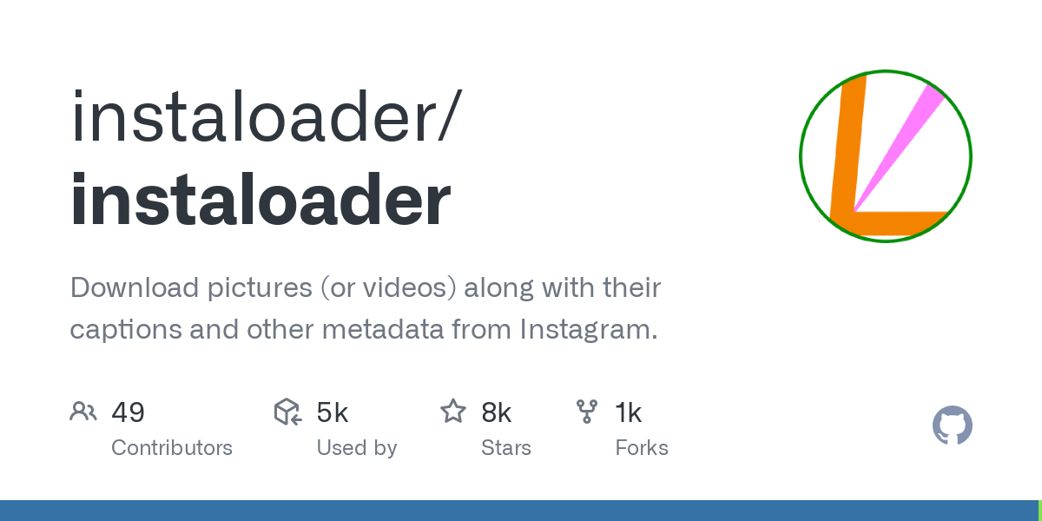
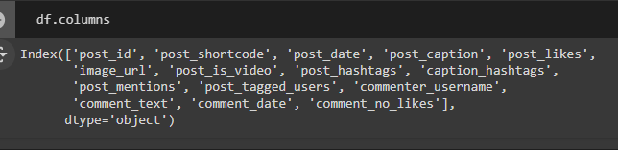
Scraping

Slide 13
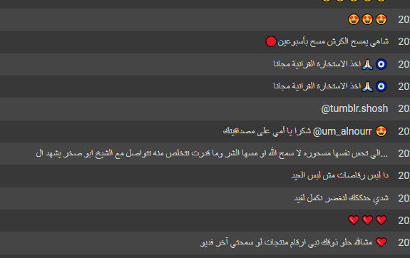
Dataset

Slide 14
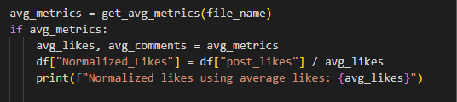

Feature Engineering
Normalized Likes
Sentiment Score
-1
+1

Slide 15

Data Cleaning

Slide 16
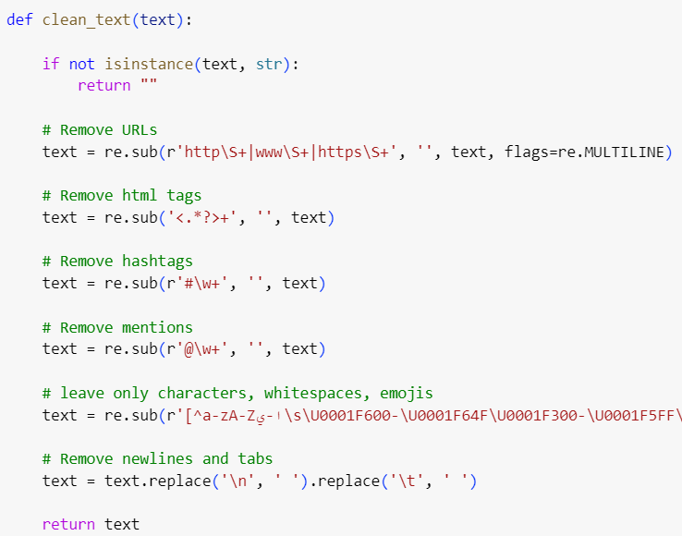
Data Cleaning
Remove URLs
Remove html tags
Remove hashtags
Remove mentions
characters, whitespaces, emojis
Replace tabs and new lines

Slide 17
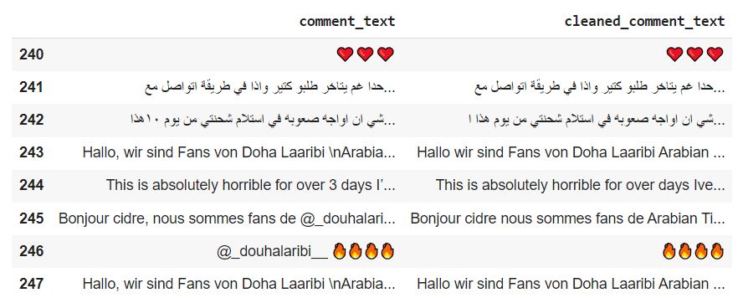
Data Cleaning

Slide 18

Sentiment Analysis

Slide 19


Sentiment Analysis

Slide 20
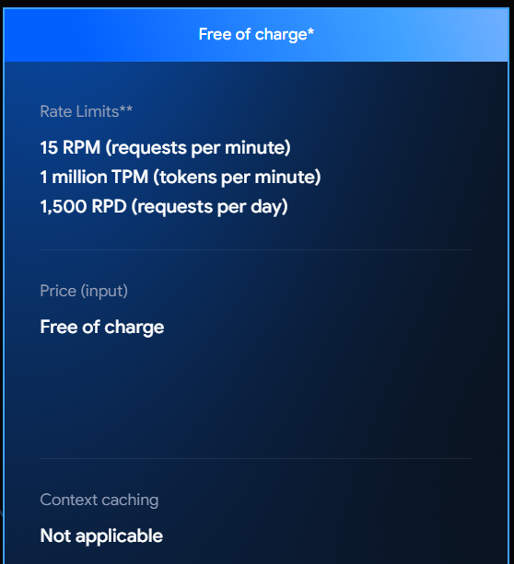
Sentiment Analysis

Slide 21
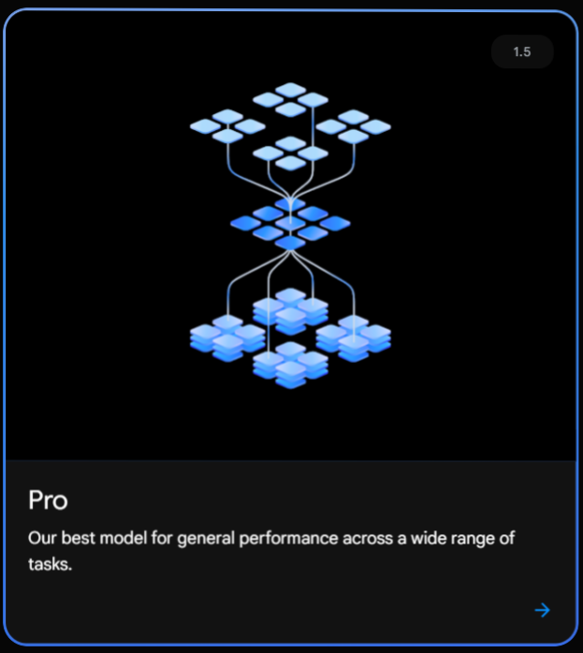
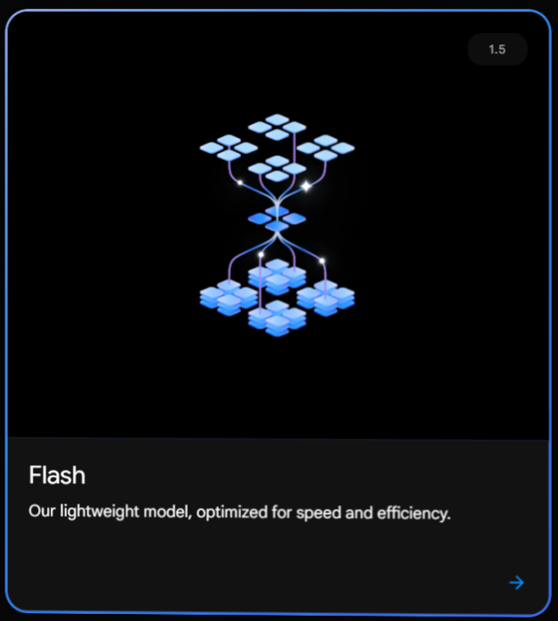
Gemini Models

Slide 22
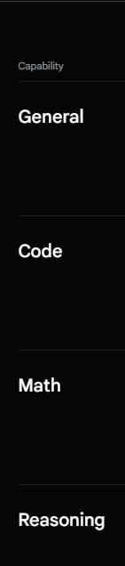
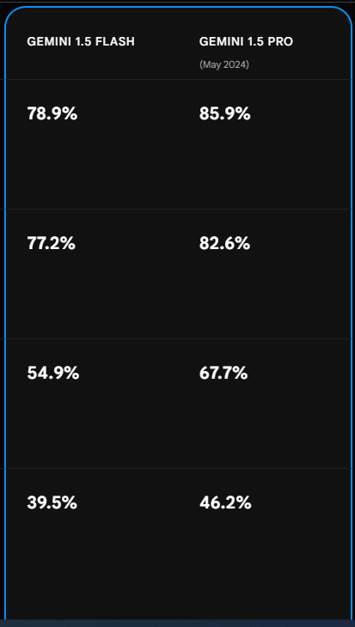
Gemini Models

Slide 23
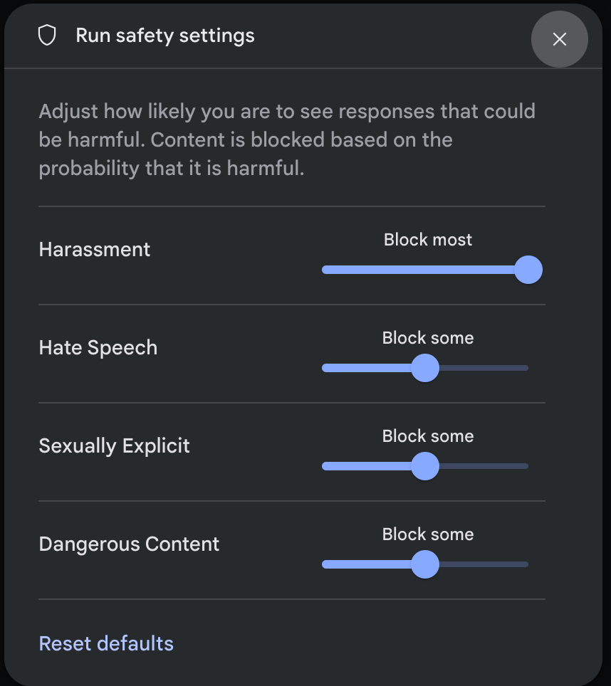
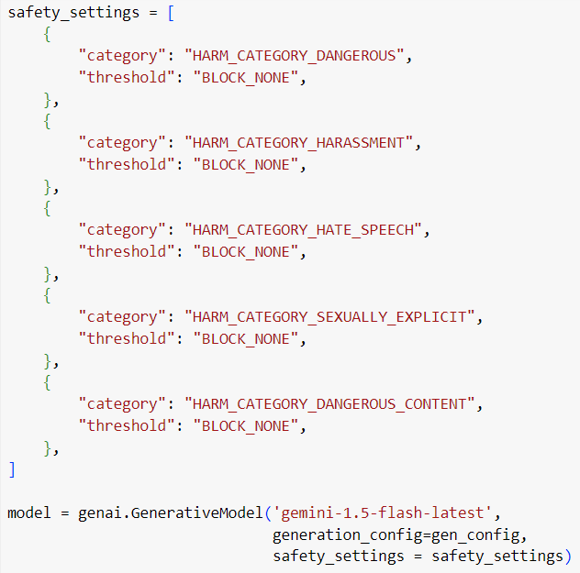
To be considered(Safety)

Slide 24
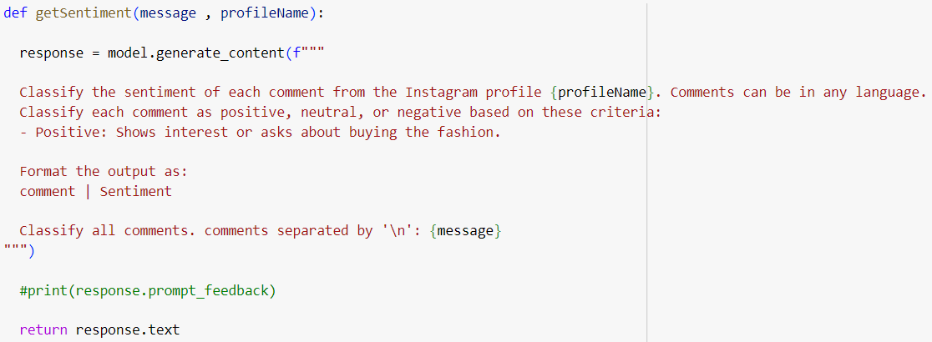
To be considered(prompt)

Slide 25
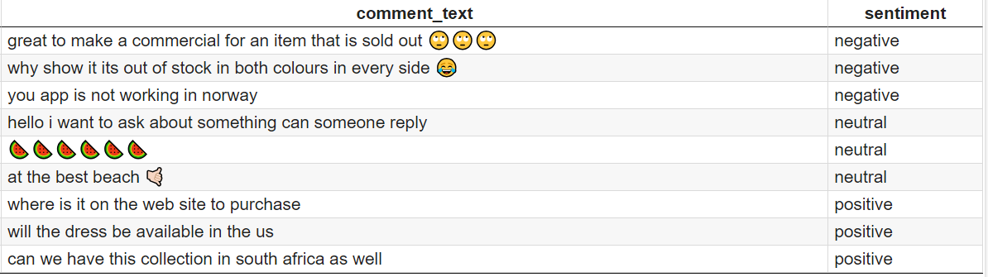
Results

Slide 26

EDA

Slide 27
EDA
Features
post_id
post_date
post_likes
Normalized_Likes
comment_count
positive_count
negative_count
natural_count
most_similar_item
is_trendy
EDA

Slide 28
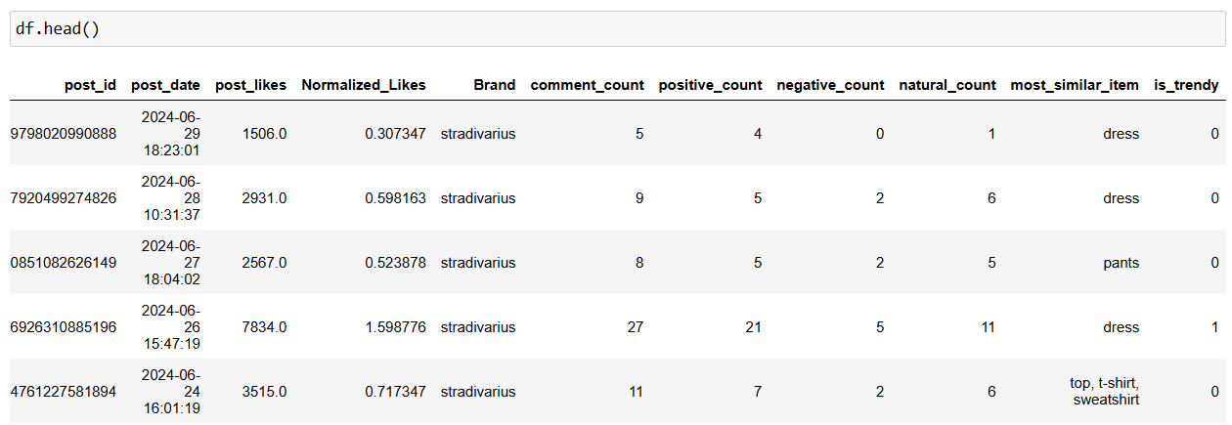
Features

Slide 29
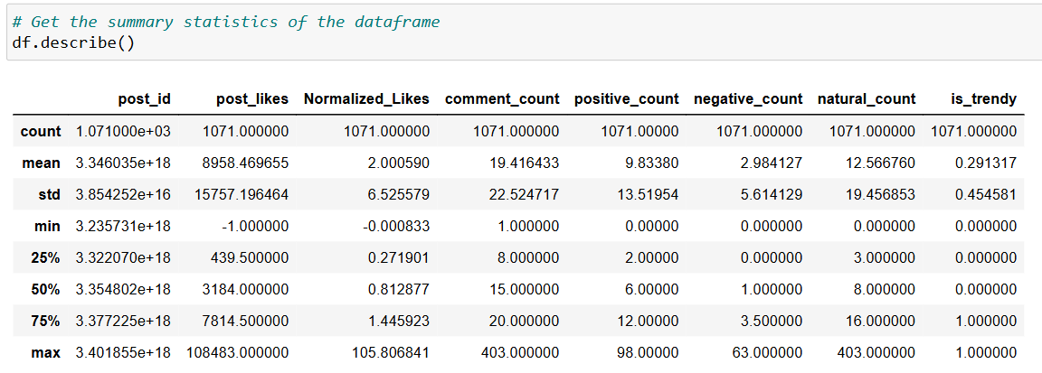
Description

Slide 30
Univariate Analysis

Slide 31
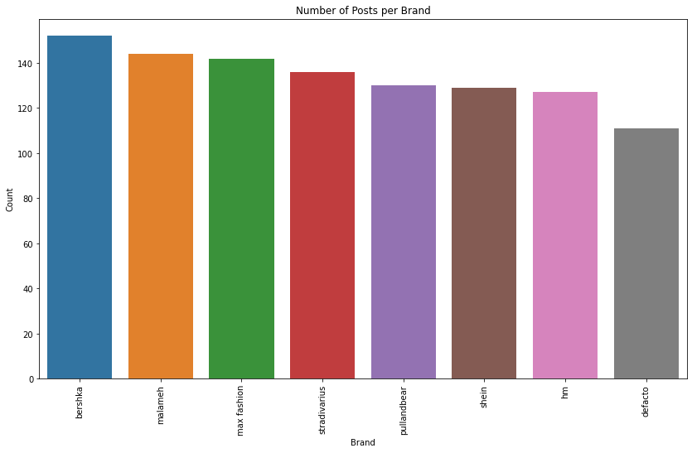
Brand

Slide 32
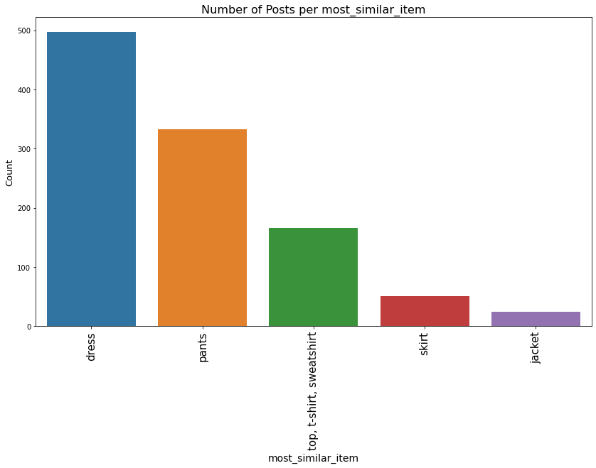
Trendy Item (most_similar_item)

Slide 33
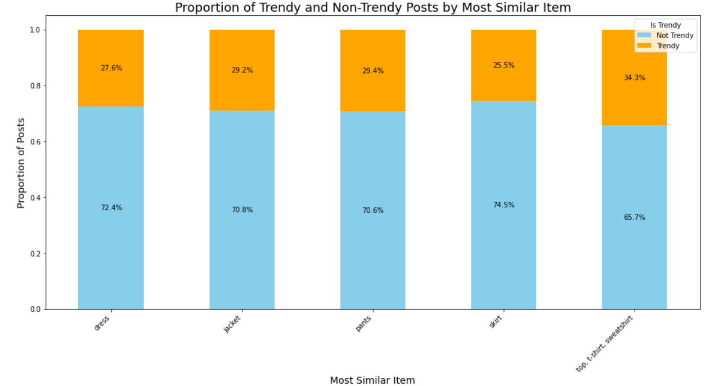
Proportion of Trendy and Non-Trendy Posts by Trendy Item

Slide 34
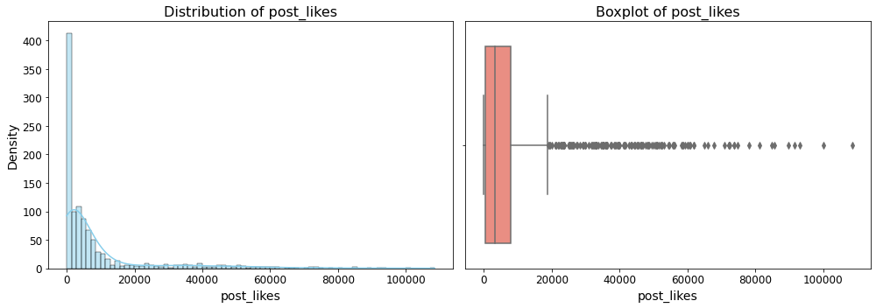
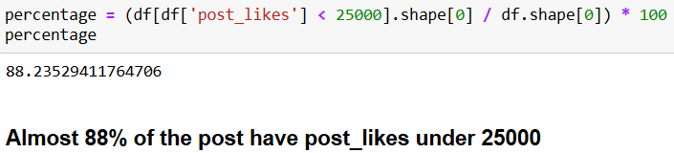
post_likes

Slide 35
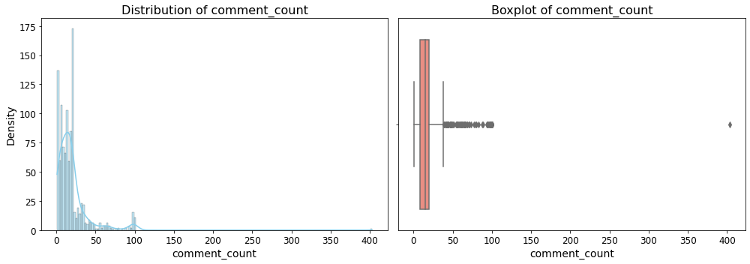
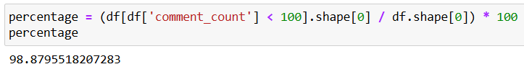
comment_count

Slide 36
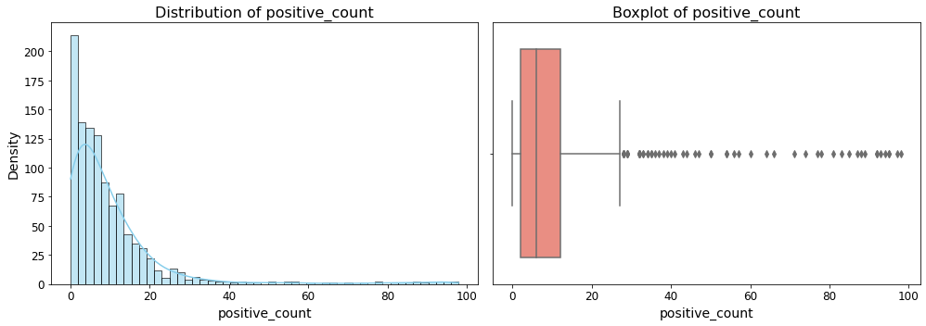
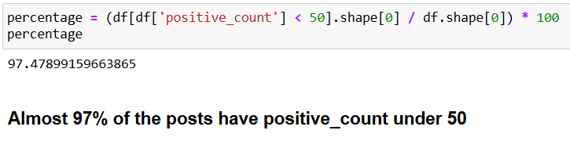
positive_count

Slide 37
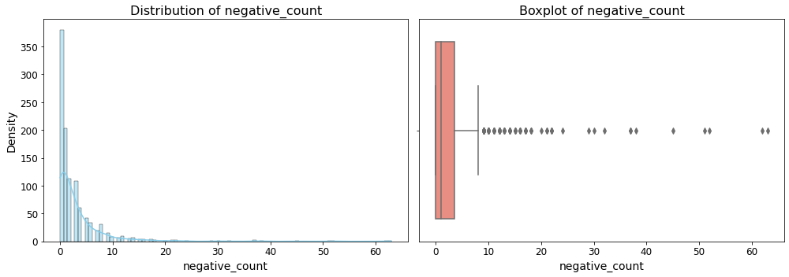
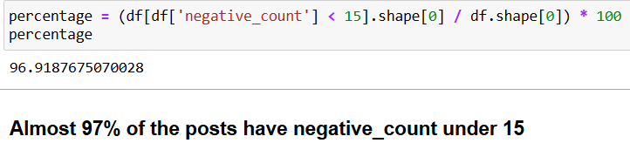
negative_count

Slide 38
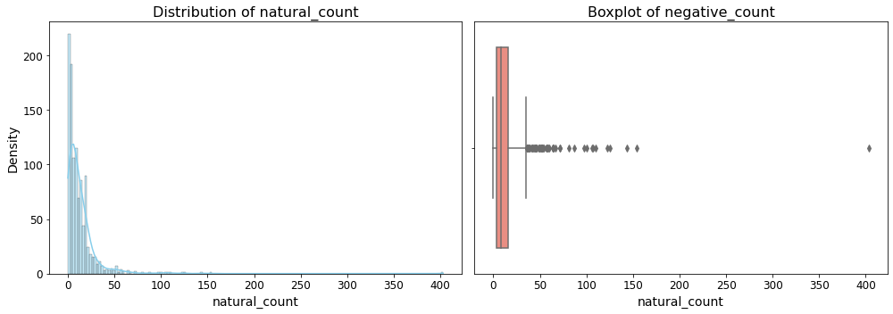
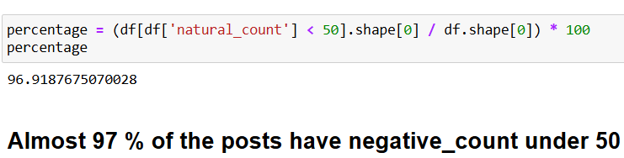
natural_count

Slide 39
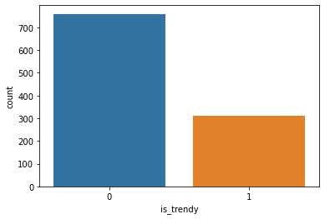
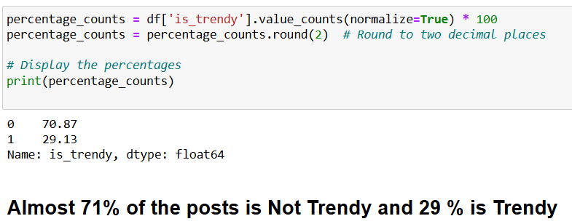
is_trendy

Slide 40
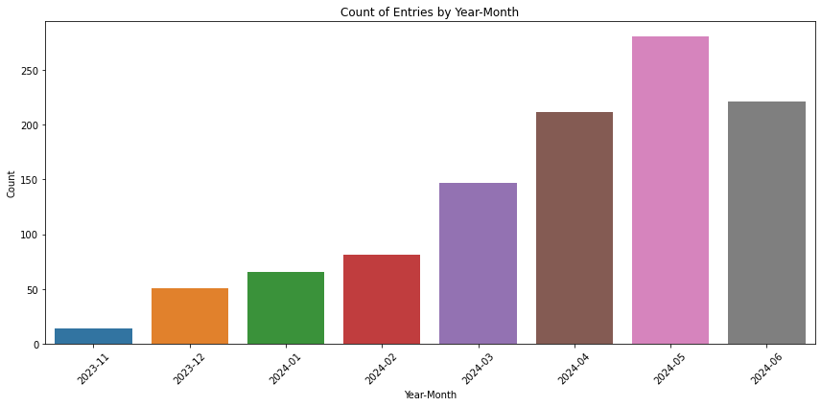
Count of Entries by Year-Month

Slide 41
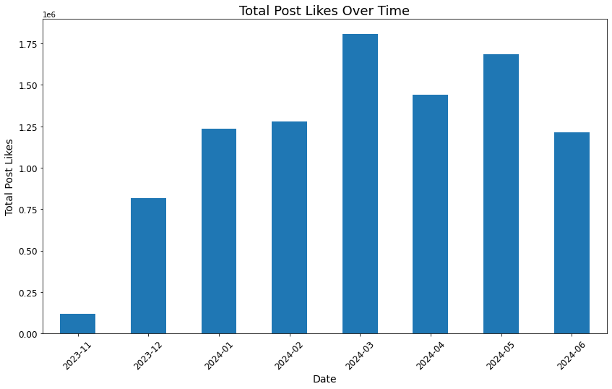
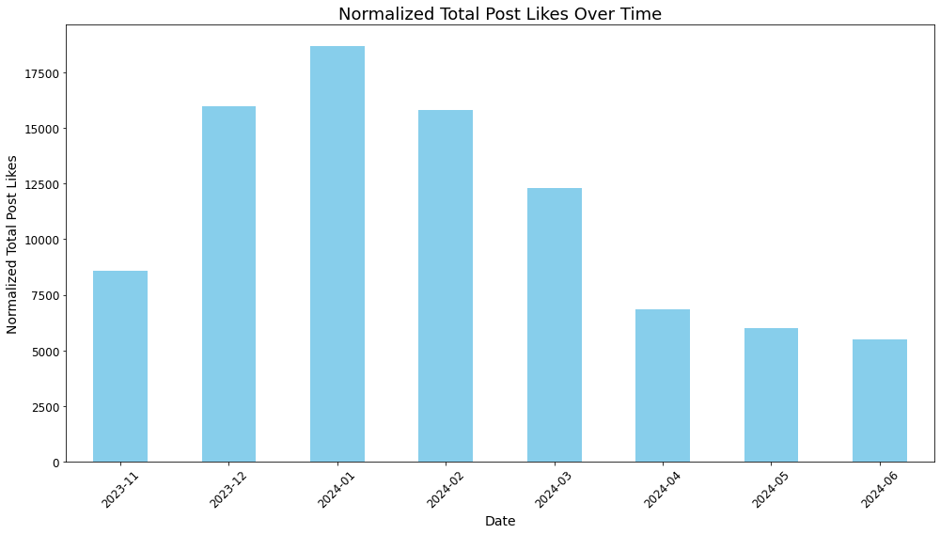
Total Post Likes Over Time

Slide 42
Multivariate Analysis

Slide 43
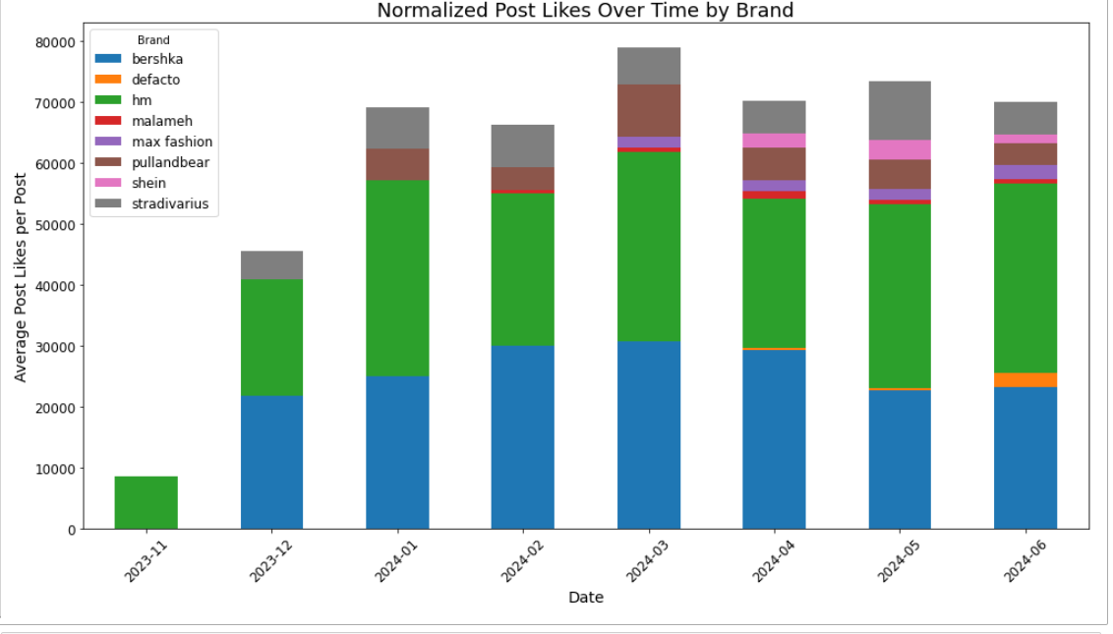
Average Post Likes Over Time by Brand

Slide 44
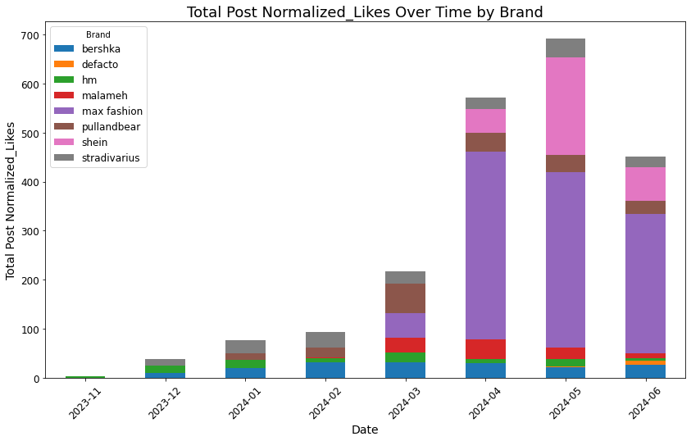
Post Normalized_Likes Over Time by Brand

Slide 45

Average Positive Scores Over Time by Brand

Slide 46


Average Negative Scores Over Timea by Brand

Slide 47

Is Trendy Distribution Over Each Brand

Slide 48

Count of Trendy and Non-Trendy Posts Over Time

Slide 49

Proportion of Trendy Posts Over Time

Slide 50

Proportion of Trendy Posts Over Time by Brand

Slide 51

Item Detection

Slide 52


Images contain more than one item.
How to know which item is being sold by the brand?

Slide 53
Comments
Post caption
Image_link
Embeddings
CV Model
Similarity
Cropped images for each item
Labels
Embeddings
Max
Relevant Item
Feature Vector
VGG16

Slide 54


CV Model : valentinafeve/yolos-fashionpedia
A fine-tuned object detection model specifically designed for fashion.
Utilizes the YOLOS architecture and has been trained on the Fashionpedia dataset.
The model can detect a wide range of fashion items such as shirts, blouses, jackets, pants, dresses, shoes, accessories like bags, belts, hats, etc.

Slide 55

YOLOS
Notes:
Let's walk through an example to illustrate this process:
Image Input:
A 224x224 image is divided into 16x16 patches, resulting in 196 patch tokens.
Patch Tokens with Positional Encodings:
Positional encodings are added to each of the 196 patch tokens.
Initialize Detection Tokens:
100 detection tokens are initialized.
Combined Sequence:
[Pat-Tok #1 + PE, Pat-Tok #2 + PE, ..., Pat-Tok #196 + PE, Det-Tok #1, Det-Tok #2, ..., Det-Tok #100].
Input to Transformer Encoder:
The combined sequence is fed into the transformer encoder.
Transformer Processing:
The transformer encoder processes the sequence, updating the detection tokens with contextual information.
Output Sequence:
The output includes the contextualized detection tokens.
MLP Predictions:
Each detection token is processed by MLP heads to predict object classes and bounding boxes.

Slide 56
Comments
Post caption
Image_link
Embeddings
CV Model
Similarity
Cropped images for each item
Labels
Embeddings
Max
Relevant Item
Feature Vector
VGG16

Slide 57
Embeddings: Trials
BERT | DistilBERT
BERT-base: 12 layers, BERT-large: 24 layers | 6 layers (half of BERT-base)
BERT-base: 110M, BERT-large: 340M | ~66M (40% smaller than BERT-base)
Masked Language Modeling (MLM), Next Sentence Prediction (NSP) | Masked Language Modeling (MLM)
Trained from scratch | Knowledge distillation from BERT
Slower, more computationally intensive | 60% faster than BERT-base
Larger, requires more memory and computational power | Smaller, more efficient and lightweight
Research, high-accuracy applications | Real-time applications, resource-constrained environments

Slide 58
Embeddings: sentence-transformers/distilbert-base-nli-stsb-mean-tokens
Fine-tuned on the STS Benchmark dataset to produce high-quality sentence embeddings.
Generates 768-dimensional vectors that capture the semantic meaning of sentences.
Then Uses mean pooling to create single fixed-size sentence embeddings, averaging token embeddings while considering the attention mask.

Slide 59
Comments
Post caption
Image_link
Embeddings
CV Model
Similarity
Cropped images for each item
Labels
Embeddings
Max
Relevant Item
Feature Vector
VGG16

Slide 60


VGG16
By using the output from "feature_extractor", which consists of all convolutional layers up to the last one.
Obtaining the deep features. These features encode complex patterns and detailed information about the image content like variations in textures and patterns.

Slide 61

Integration

Slide 62

Put them all together ..
Instagram Login [instaloader]
Page Selection
Page Stats [instagram analyzer]
Post Scraping [instaloader]

Slide 63
Put them all together ..
Download Image [requests]
Clean Comments
Item Detection [Yolo - Bert]
Sentiment Analysis [Groq api "Mixtural – Llama 70B"]

Slide 64
Sentiment Score
Normalize Likes&Comments/Page
Investigate correlation (Likes – Comments – Sentiment Score)
Cutting Threshold (Trending or Not)
Put them all together ..

Slide 65

Put them all together ..

Slide 66

Put them all together ..

Slide 67

Put them all together ..

Slide 68

User Interface

Slide 69

Landing Page

Slide 70

Step 1: Login to Instagram

Slide 71

Step 2: Select a Fashion Brand

Slide 72

Step 3: Enter Instagram Post Link

Slide 73

Step 4: Clean Comments

Slide 74


Step 5: Select a Fashion Item From the Image

Slide 75

Step 6: Perform Sentiment Analysis

Slide 76

Step 7: Sentiment Analysis Results

Slide 77

Step 8: Trendy Decision

Slide 78

Future Work

Slide 79



Clustering and Cluster Analysis
Main Features
Numerical Statistical data
Normalized Sentiment Score
Normalized Comments Count
Normalized Likes
K-Means
Hierarchal
DBSCAN

Slide 80


Dimensionality Reduction

Slide 81



Classification
Included feature
Item Image feature embedding.
Random Forrest
SVM

Slide 82

XGBoost Metrics

Slide 83
Thank You!

